Slide 1
Adding Text and Structure
Lecture 5

Slide 2
Learning Objectives
By the end of this session students should be able to;
Gain an understanding of the basic XHTML structure
Gain an understanding of some of the basic that you need to know about text.
Learn how to structure content
Gain an understanding of XHTML lists
Learn how to created number and bulleted lists
Learn how to format text
Learning how to copy and existing text into Dreamweaver
Learn how to import an entire Word document into an HTML page

Slide 3
Understanding Web Page Structure with HTML
The way your web page is built determines what kind of content it shows and how that content appears in a browser.
Behind the scenes, there's a special kind of code called XHTML that sets up this structure. Think of it like the blueprint for a house—it tells the browser where things go and how they should look.
Let's explore some basic parts of XHTML and learn simple ways to use them effectively.

Slide 4
Basic HTML Structure Elements
<!DOCTYPE html> Declaration
Declares the document type.
Tells the browser you're using HTML5.
<html>
The root element of the page.
Wraps all the content.
<head> Section
Contains metadata (info about the page).
Includes:
<title>: Sets the page title (shown in browser tab).
<meta>: Describes page encoding, author, etc.
<link>: Connects to external stylesheets.
<style>: Adds internal CSS.
<script>: Adds JavaScript.

Slide 5
Basic XHTML Structure Elements Cont..
<body> Section
Holds everything visible on the page.
Includes:
Headings (<h1> to <h6>)
Paragraphs (<p>)
Images (<img>)
Links (<a>)
Lists (<ul>, <ol>, <li>)
Tables (<table>, <tr>, <td>)
Forms (<form>, <input>, <textarea>)

Slide 6
Tips for Using XHTML Effectively
Always close your tags: XHTML is stricter than HTML.
Example: </br> instead of <br>
Use lowercase for all tags.
Nest elements properly—don’t leave tags hanging.
Include the alt attribute for images to improve accessibility.

Slide 7
Do Exercise Demonstrating HTML Elements on the handout given

Slide 8
CASCADING STYLE SHEET (CSS)
Week 5

Slide 9
Overview
Example CSS
A Cascading Style Sheet (CSS) is a stylesheet language used to control the presentation and layout of HTML elements on a webpage. It allows developers to separate content (HTML) from design (CSS), making websites easier to maintain and more visually appealing.
What CSS Does
Controls colors, fonts, and spacing
Defines layout (grid, flexbox, positioning)
Adds animations and transitions
Enables responsive design for different screen sizes
body {
background-color: #f0f0f0;
font-family: Arial, sans-serif;
margin: 0;
padding: 0;
}
h1 {
color: navy;
text-align: center;
}
p {
font-size: 16px;
line-height: 1.5;
}

Slide 10
Understanding CSS
A style sheet is a collection of these styles that can be applied to a single page in your site, a range of pages or the entire site. CSS lets you control many properties that cannot be controlled with HTML alone, such as specifying font sizes.
CSS styles work like styles in programs like Word—you define a style once for elements like headings, and any changes to that style automatically update all matching elements across the page.
CSS lets you manage the design of your whole website from a single file. By linking all pages to that file, you can easily update the site's appearance in one place.

Slide 11
Understanding CSS CONT..
CSS style sheets are files or blocks of code that define how HTML elements should look. They can be written in three main places that styles can be placed:
External Style Sheet
Stored in a separate .css file and then linked to HTML using <link> tag
Best for large projects and consistent styling across multiple pages.
Example: <link rel="stylesheet" href="styles.css">
/* styles.css */
body {
background-color: #fff;
font-family: 'Segoe UI', sans-serif;
}

Slide 12
Understanding CSS CONT..
Internal Style Sheet
Written inside a <style> tag in the <head> of your HTML
Good for single-page styling.
<head>
<style>
h1 {
color: teal;
}
</style>
</head>
Inline Styles
Applied directly to an HTML element using the style attribute
Example:<p style="color: blue; font-size: 16px;">Hello World</p>

Slide 13
Anatomy of a CSS Rule
A CSS rule is made up of two main parts:
the selector
and the declaration block.
Here’s a breakdown of its anatomy:
selector {
property: value;
}
Selector
Identifies which HTML elements the rule applies to.
Examples: p targets all <p> tags
.className targets elements with a specific class
#idName targets an element with a specific ID.
2. Declaration Block
Contains one or more declarations, enclosed in {}.
Each declaration includes:
Property: The style attribute you want to change (e.g., color, font-size).
Value: The setting for that property (e.g., blue, 16px).
p { color: blue; font-size: 16px; }

Slide 14
Understanding Selector Types
A selector tells CSS which HTML element you want to style.
Common Selector Types
Selector Type | What It Targets | Example CSS Rule | What It Does
Universal (*) | All elements | * { margin: 0; } | Removes margin from everything
Type (tag) | Specific HTML tags | p { color: blue; } | Makes all <p> text blue
Class (.name) | Elements with a class | .box { border: 1px solid; } | Styles anything with class “box”
ID (#name) | One unique element by ID | #header { font-size: 24px; } | Styles the element with ID “header”
Group (a, p) | Multiple elements together | h1, h2 { color: red; } | Makes both <h1> and <h2> red
Descendant | Elements inside another | div p { color: green; } | Styles <p> inside <div> only
Child (>) | Direct children only | ul > li { list-style: none; } | Styles only direct <li> in <ul>
Sibling (+) | Next element after another | h1 + p { margin-top: 0; } | Styles <p> right after <h1>
Attribute | Elements with certain attributes | input[type="text"] {} | Styles text input fields only

Slide 15
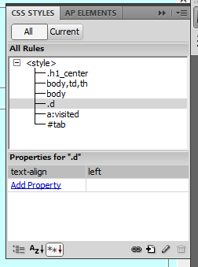
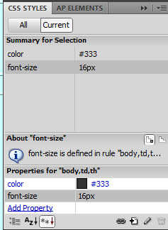
The CSS Style Panel
The CSS Styles Panel in Dreamweaver is your main control center for working with CSS. It gives you a complete overview of all the styles used on the page through the All tab, and lets you zoom in on the specific styles applied to the selected element using the Current tab.
You can also use this panel to make new style rules, change or delete existing ones, and link external CSS files to your page.

Slide 16
The New CSS Rule Dialogue Box
No matter how you create a CSS rule in Dreamweaver, the New CSS Rule dialog box will appear. For a quick class style on selected text, you might use the Properties Inspector. But for more complex rules—like styling images in a sidebar—the CSS Styles Panel is the better choice.

Slide 17
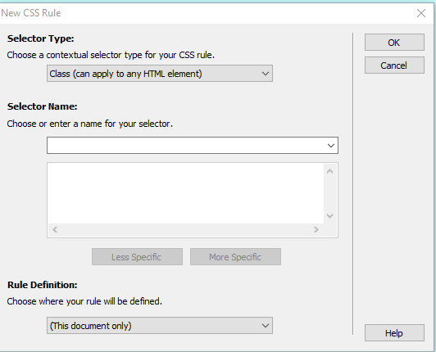
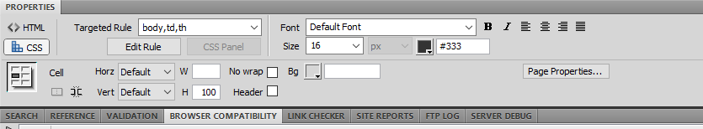
Components of the New CSS Rule Dialog Box in Dreamweaver
Selector Type: Choose whether the rule targets a tag (e.g., p), class (e.g., .highlight), ID (e.g., #sidebar), or compound selector.
Selector Name: Enter the name of the tag, class, or ID you want to style.
Rule Definition Location: Decide where to save the rule—either in an external style sheet or embedded in the current HTML file.
CSS Properties Editor: After creating the rule, this section lets you define styles like font, color, margin, padding, borders, etc.

Slide 18
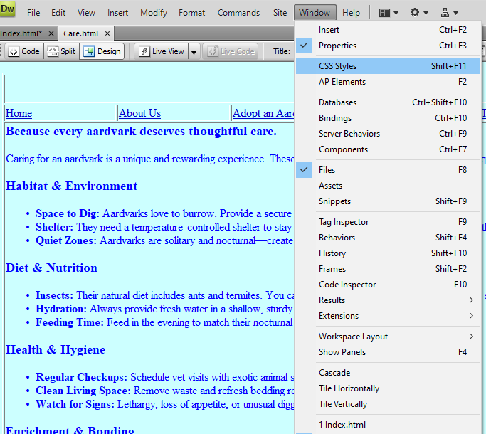
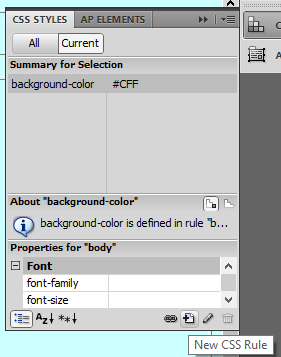
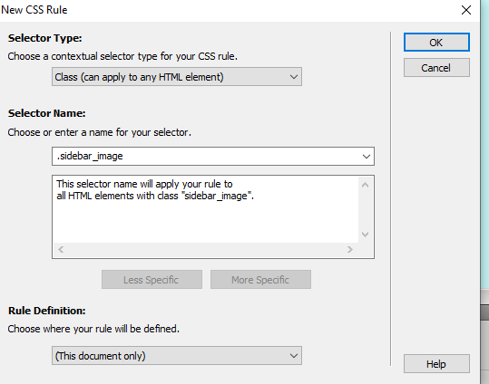
How to Create CSS Rules with the CSS Styles Panel
Open the Panel
Go to Window > CSS Styles to open the CSS Styles Panel.
Click “New CSS Rule”
At the bottom of the panel, click the + icon to start a new rule.
Use the New CSS Rule Dialog Box
Choose a selector type: Tag, Class, ID, or Compound.
Name your selector: For example, .sidebar-image.
Choose where to save the rule: External stylesheet or embedded in the page.
Click OK to continue.
Define Style Properties
In the next window, set your styles:
Font, color, background
Margins, padding, borders
Layout and positioning
Apply the Rule to HTML
Add the class or ID to your HTML element:

Slide 19
Why Use the CSS Styles Panel?
Easy to create and manage styles visually
Keeps your CSS organized
Great for both simple and advanced styling

Slide 20
Creating Rules with the Properties Inspector
The Properties Inspector is split into HTML and CSS modes. Use CSS mode for styling and HTML mode for structural tweaks. You can switch between them depending on your task.
Open the Properties Inspector
Make sure the Properties Inspector is visible by going to Window > Properties.
Switch to the CSS mode by clicking the "CSS" button if you're not already in it.
Select the Element You Want to Style
Click on any text or HTML element in Design View.
The Properties Inspector will show the current styling and allow you to modify it.
Create or Edit a CSS Rule
Use the "Targeted Rule" dropdown to select an existing rule or choose "New CSS Rule.
"Click "Edit Rule" to open the CSS Rule Definition dialog box.
Define properties like font, color, margins, and alignment.
Apply Styles and Preview
After defining your rule, apply it to the selected element.
Use Live View or Preview in Browser to see the changes in action.

Slide 21
Creating Rules with the Properties Inspector Cont..
Advanced Styling with External Style sheets
You can link external style sheets and manage rules globally.
This is ideal for consistent styling across multiple pages.
Styling Specific Elements Like Images
You can use the Properties Inspector to assign classes and style images.
For example, center an image or adjust its margins using CSS rules.

Slide 22
Thank you ☺

